Slide 1


PREDICTIVE ANALYSIS
INTRODUCTION, REGRESSION, TIME SERIES ANALYSIS
data-action-lab.com

Slide 2
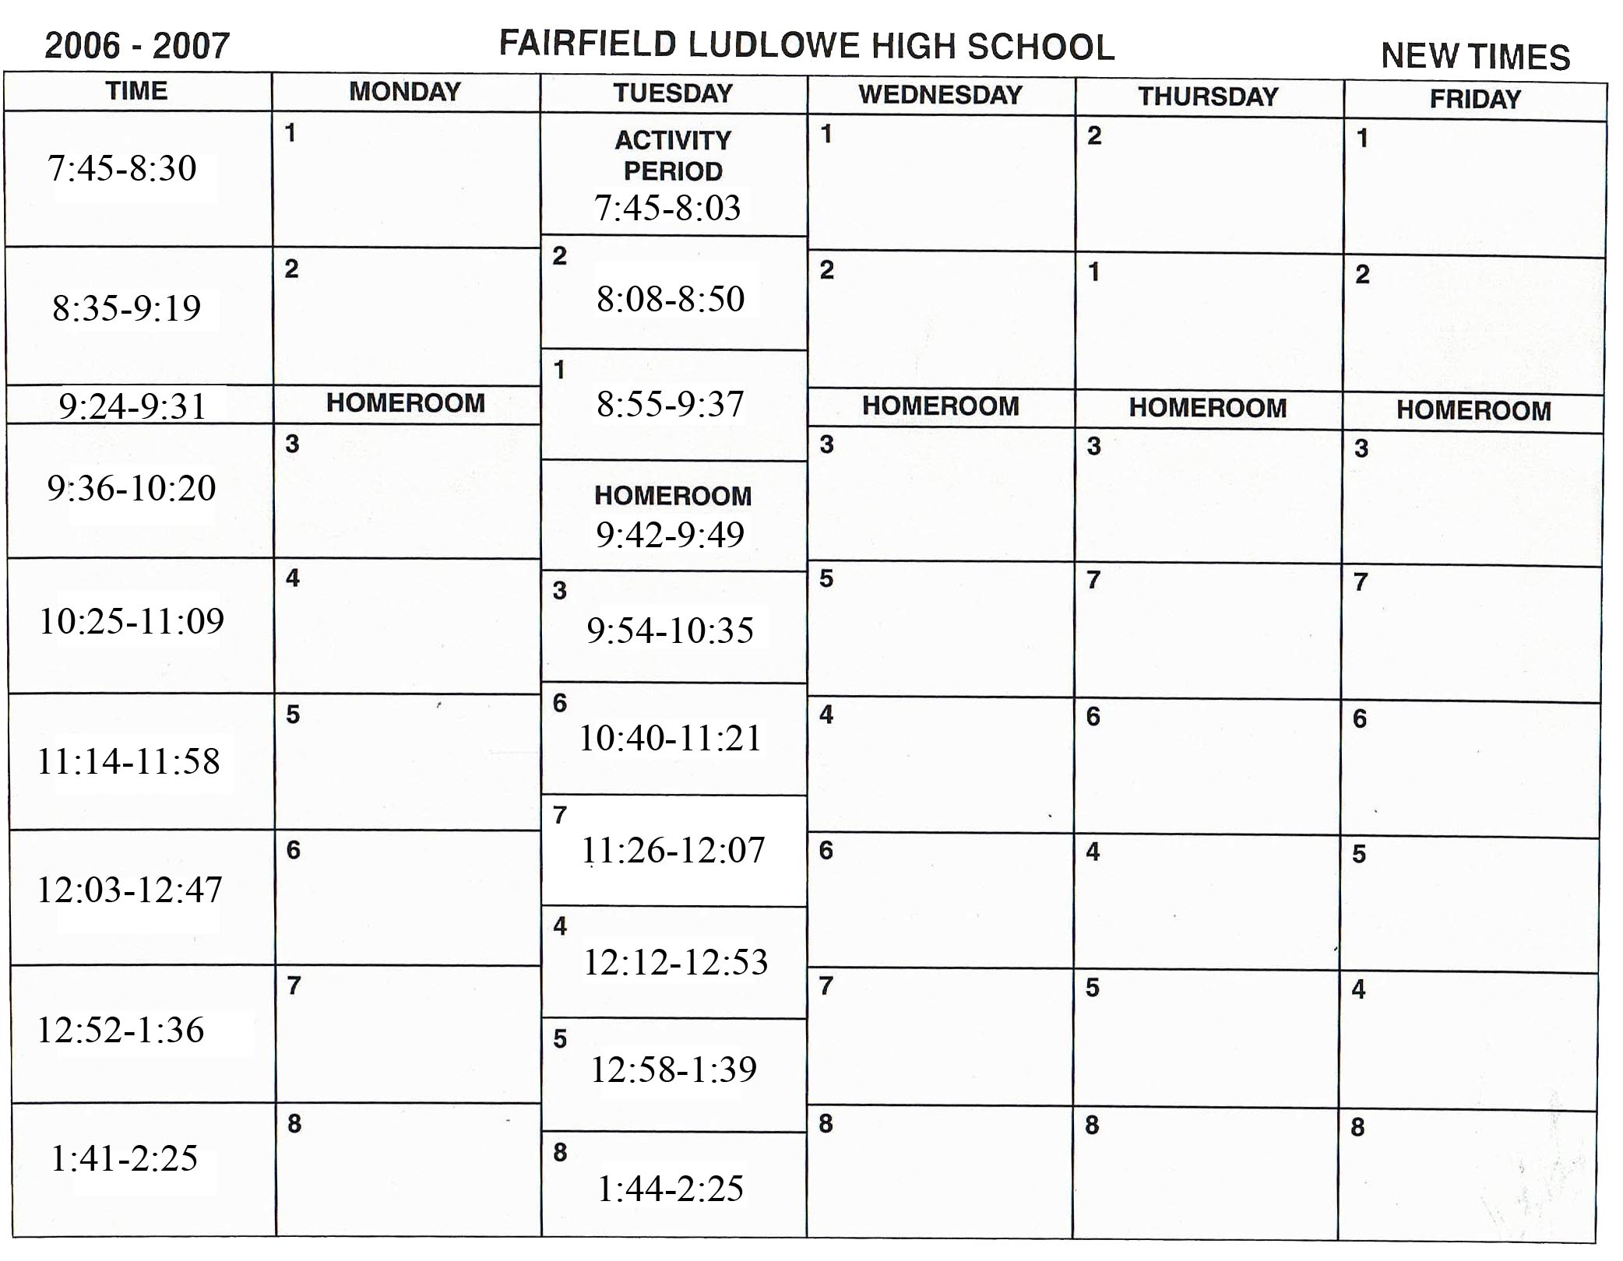
PREDICTION – AN ATTAINABLE GOAL?
We are better at predicting than we might admit.
As well, we often set up our environment so that it is more predictable.
At the same time, we continue to try to push the boundaries of what we are able to predict.

Slide 3
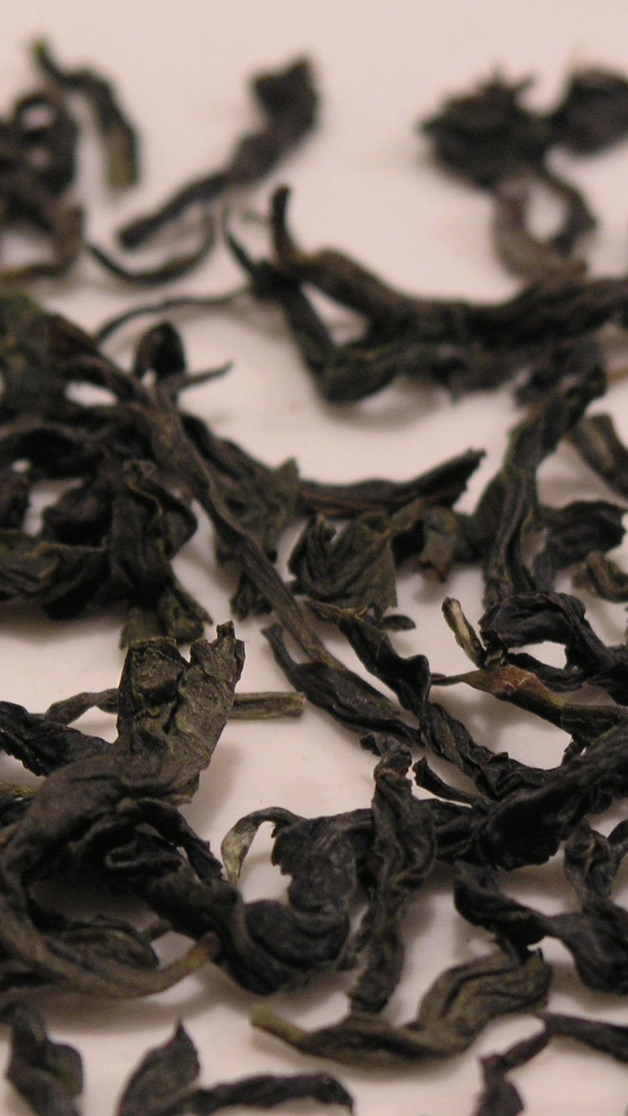
SOOTHSAYERS, FORTUNE TELLERS AND PROGNOSTICATORS
Over time, we have tried many strategies to predict the future:
Divination
Rituals
Dreams and Trances
Our enjoyment of games of chance suggest that sometimes we like an element of not knowing.
The development of probability and statistics offered up a way to quantify what we do know, and formalize our efforts to predict what we don’t know.

Slide 4
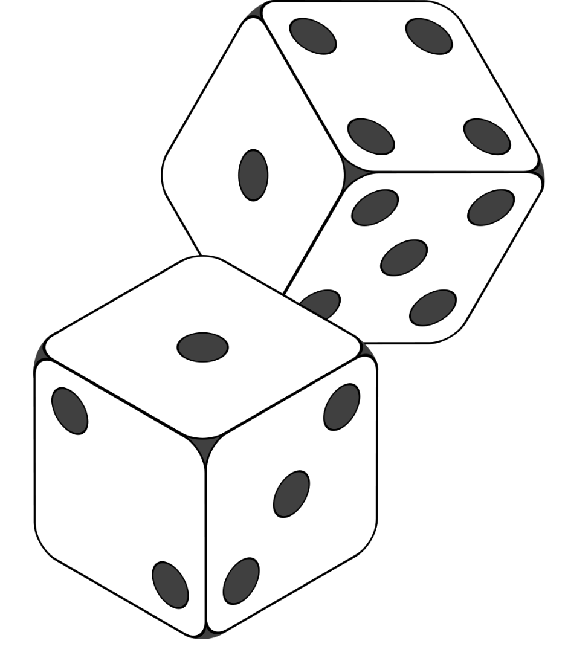
History of PROBABILITY
Prior to 1700s: Many cultures around the world develop concepts relating to possible combinations and permutations of events, as well as the odds of events happening.
1700s: Probability starts to have a sound mathematical basis (e.g. concept of an expected value).
1800s: A variety of fundamental concepts and tenets of modern probability theory are developed.
1900s: Statistics becomes more fully integrated into the scientific method. The frequentist vs Bayesian debate emerges.
Art: Steaphan Greene [CC BY-SA 3.0 (https://creativecommons.org/licenses/by-sa/3.0)]

Slide 5
Regression Analysis – The Basics

Slide 6
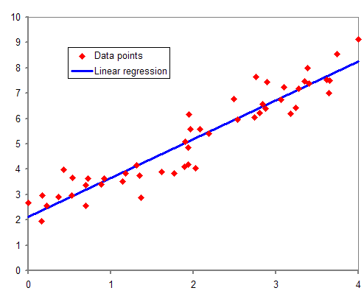
Regression Analysis – Some Background
Devised by Legendre and Gauss, independently, in the context of analyzing astronomical observations.
Galton coined the term ‘regression’ with respect to a specific biological context (relating to human height)
This term stuck, however. It is now used more generally to describe estimating the relationship between a dependent and independent variables.
(https://en.wikipedia.org/wiki/Regression_analysis)

Slide 7
Time Series Analysis

Slide 8
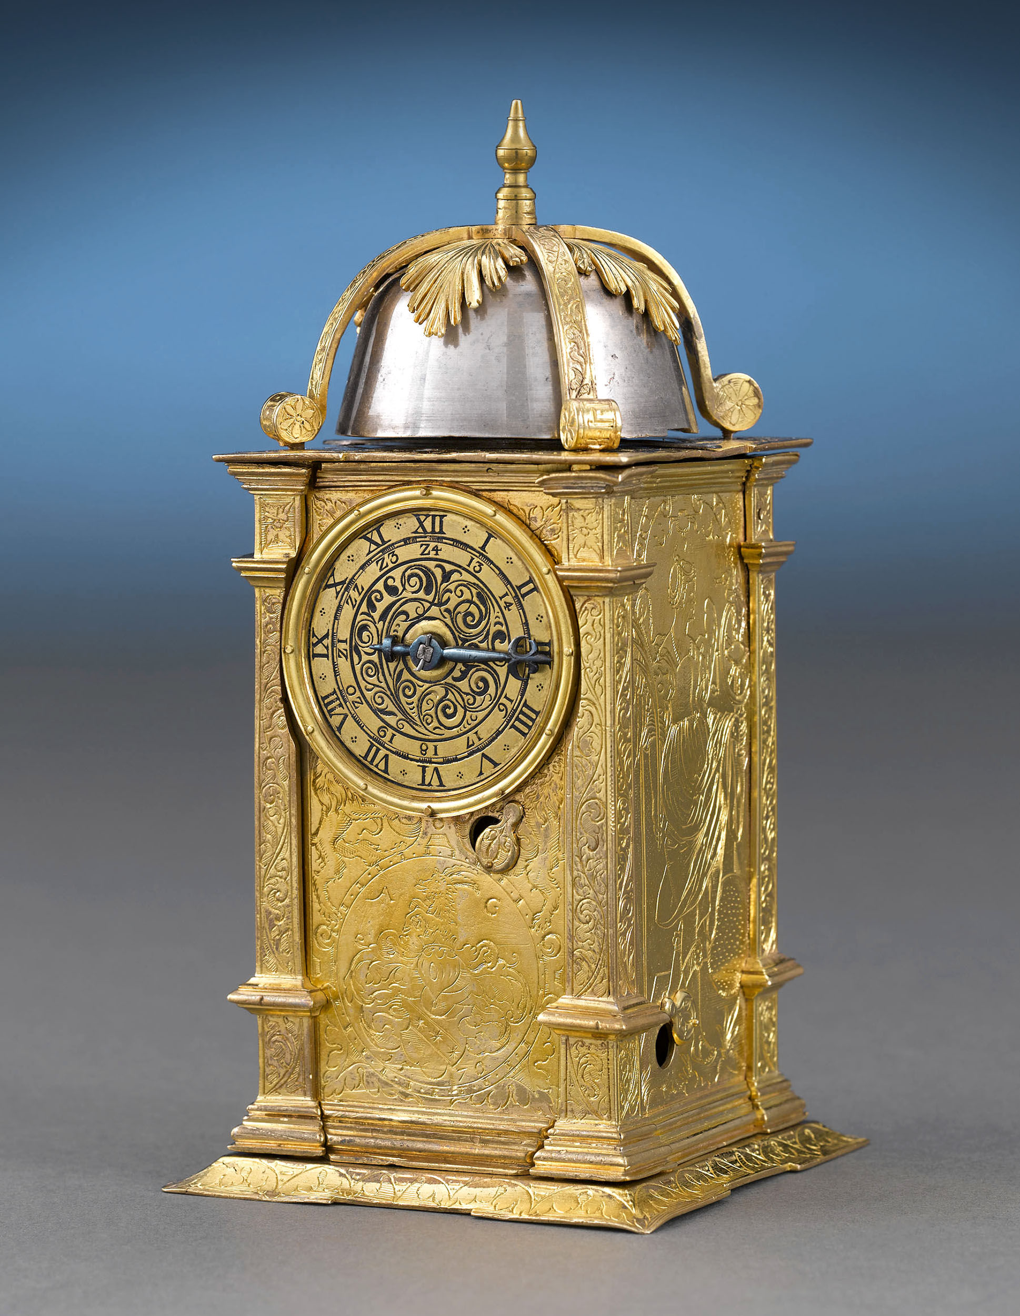
A Matter of Time
When one of our independent variables is time, we can use specialized techniques to model the relationships between time and other variables.
This is referred to as time series analysis.
Rauantiques [CC BY-SA 4.0 (https://creativecommons.org/licenses/by-sa/4.0)]

Slide 9
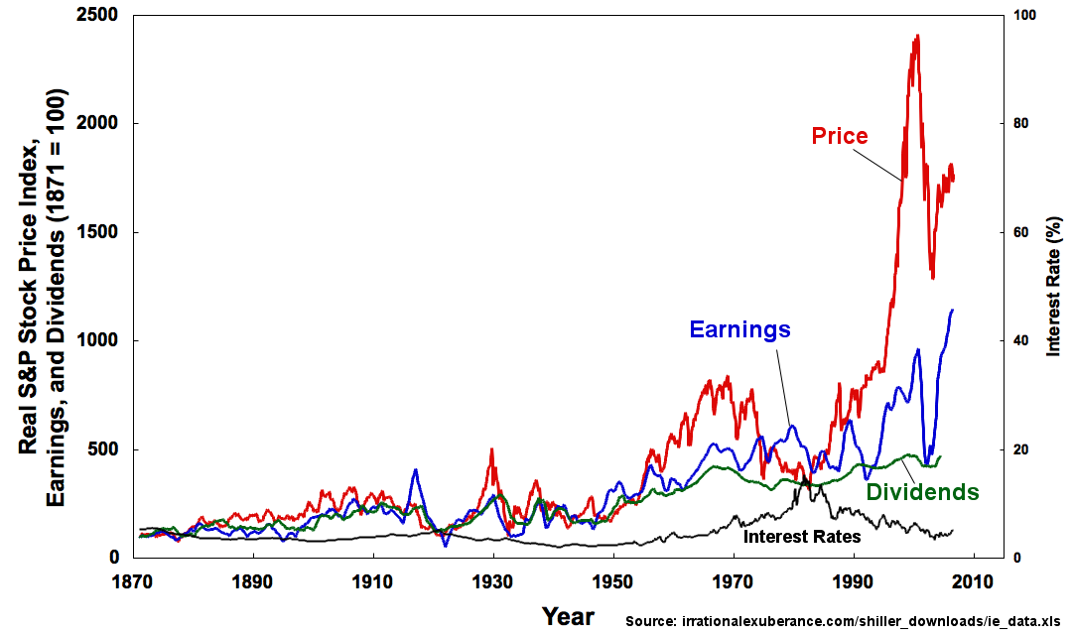
Time Series Analysis
A simple time series has two variables: a time variable, and second variable
What is the pattern of behaviour of this second variable over time?
Can we use this information to forecast the behaviour of the variable in the future?

Slide 10
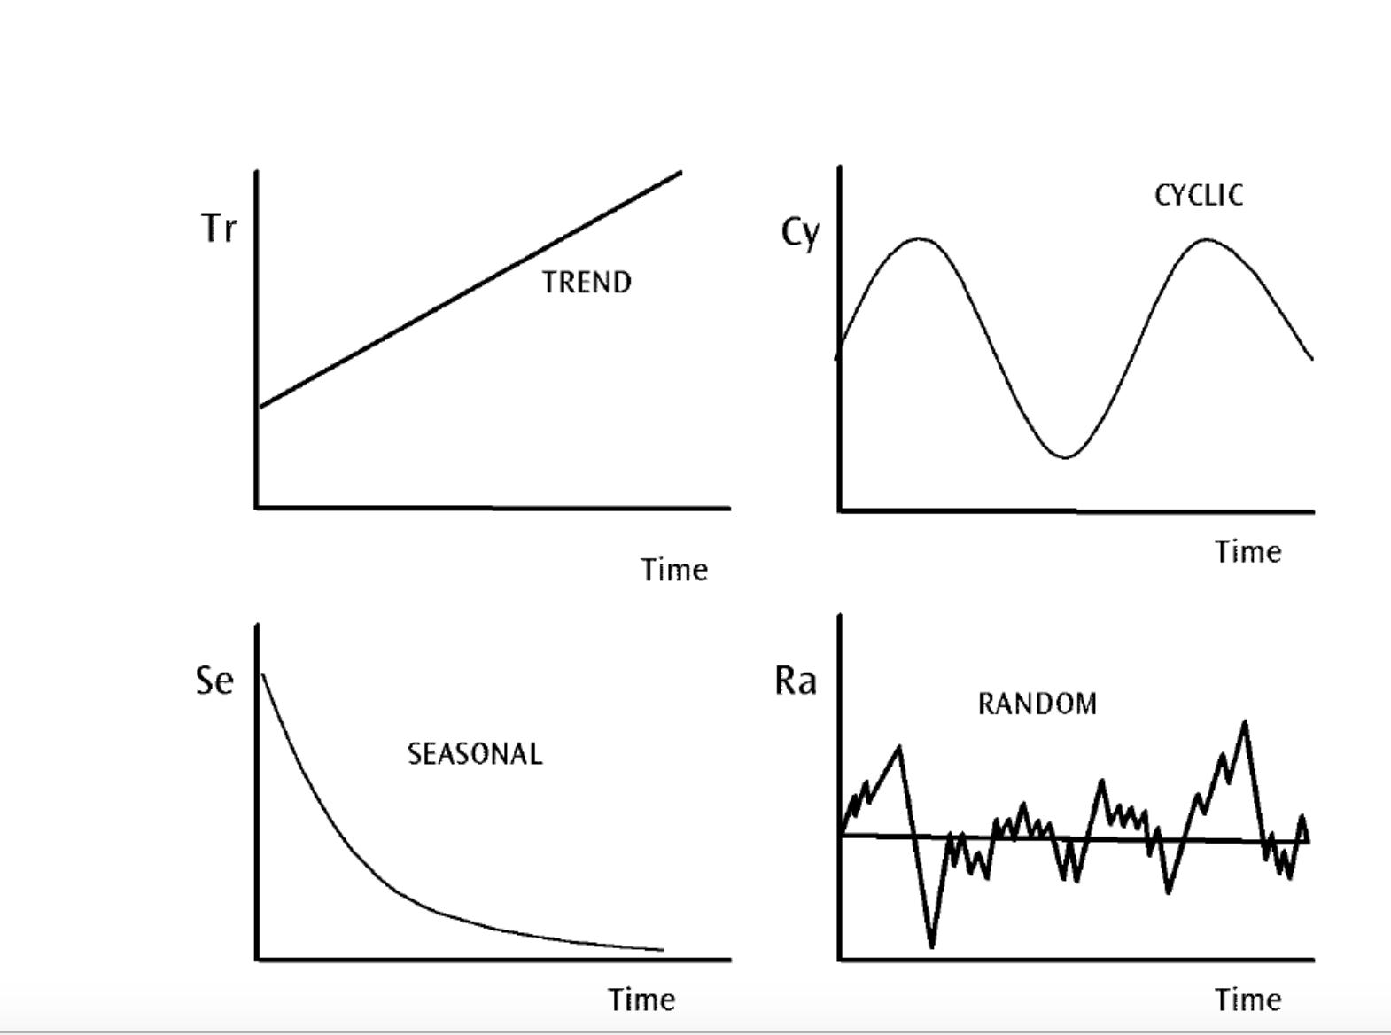
Temporal Patterns
The goal here is our familiar analysis goal:
find patterns in the data
create a (mathematical) model that captures the essence of these patterns

Slide 11
Temporal Patterns
The patterns can be quite complex – some ‘fancy’ analysis typically required!
In particular – the overall series can often be broken down into being made up of multiple component models.
Common techniques involve moving averages – e.g. ARIMA.
There are software libraries that can help!

Slide 12
OTHER PREDICTION STRATEGIES?

Slide 13
The New Kids On the PREDICTION BLOCK
Regression is a tried and true strategy for prediction.
Regression techniques frequently rely on certain assumptions – e.g. about the appropriate underlying model.
Are there other techniques that might be useful for prediction?
Enter machine learning techniques.
Right now, neural network are a popular predictive technique.

Slide 14
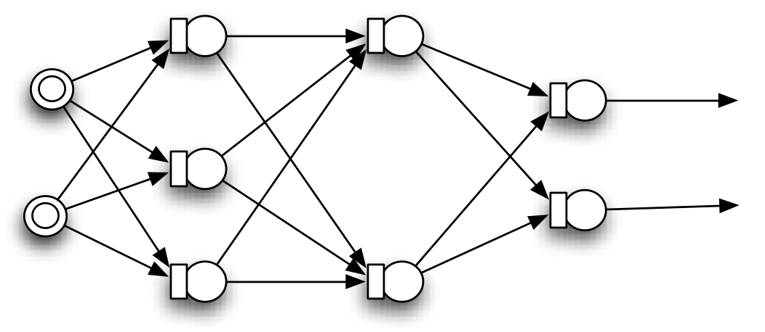
NEURAL NETWORKS

